Slide 1

Project Update: Real-Time Actionable Banking Chatbot
Project Goal: Develop a banking chatbot capable of real-time actions like blocking credit cards.
Current Status: Implemented and tested different approaches.
Objective: Provide an update on the progress and future steps.
Photo by Kaleidico on Unsplash

Slide 2

First Approach: LLM Model (Gemma)
Custom Dataset: Created a dataset tailored to specific banking queries.
Training Process: Fine-tuning the LLM model using advanced techniques.
Tools and Libraries: Utilized TensorFlow, PyTorch for model training.
Performance: Evaluated using metrics like accuracy, precision, recall.
Outcome: Successfully trained model delivering accurate responses.
Photo by The CEO Kid on Unsplash

Slide 3

Second Approach: LangChain and GPT API
Chat Retrieval Chain: Implemented to retrieve relevant information.
Function Triggering: Set rules and conditions for triggering functions.
Tools and Libraries: Used OpenAI API, LangChain framework.
Capabilities: Enabled actions like blocking credit cards, updating records.
Outcome: Successfully integrated function triggering with chat responses.
Photo by Austin Distel on Unsplash

Slide 4

Implementation Environment
Streamlit: Frontend interface for the chatbot, providing a chat-like environment.
Flask API: Backend logic handling data queries and interactions.
Integration: Communication between Streamlit frontend and Flask backend.
Features: Real-time data actions such as blocking credit cards.
Photo by Nate Grant on Unsplash

Slide 5

Current Status and Testing
Testing Environment: Final testing in Jupyter Notebook.
Trial Mode: Both approaches currently in trial mode.
Progress: Summary of testing results, including successes and issues.
Next Steps: Immediate tasks and fixes identified during testing.
Photo by Thought Catalog on Unsplash

Slide 6
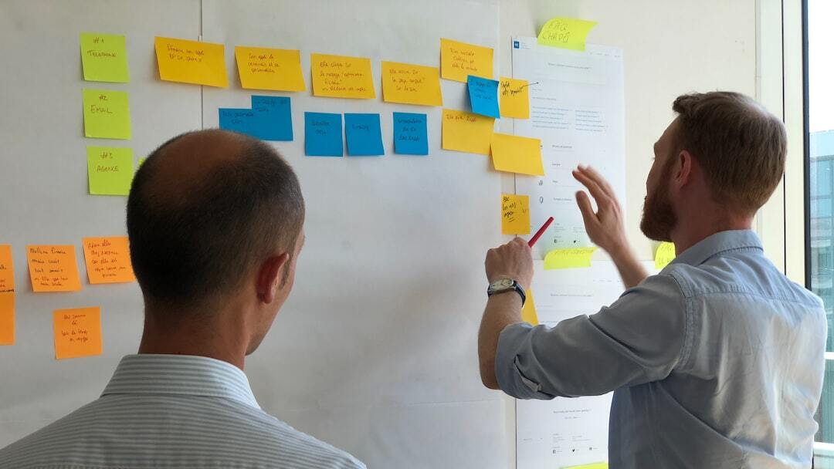
Next Steps
Immediate Tasks: Final testing and debugging in Jupyter Notebook.
Integration: Transitioning from trial mode to production.
Deployment: Deploying the chatbot on the banking platform.
Completion Timeline: Expected completion within the next 3-5 days.
Photo by Sebastien Bonneval on Unsplash

Slide 7
Current Status and Testing
Testing Environment: Using Jupyter Notebook for final testing.
Trial Mode: Current setup in trial mode for both approaches.
Progress: Summary of testing results and ongoing work.
Next Steps: Immediate tasks to be completed in the next 3-5 days.
Photo by Thought Catalog on Unsplash

